Slide 1
Employee Management System
DataBase Systems.
To M’s Kainat Nazir.

Slide 2
1. Introduction:
The Employee Management System (EMS) is a database project aimed at efficiently managing employee-related information within an organization. It provides a centralized platform for storing, retrieving, and managing various data related to employees, including personal details, job information, attendance records, salary details, and performance evaluations.

Slide 3
2. Work and Use:
The Employee Management System consists of several modules that cater to different aspects of employee management:
Employee Information Module
Attendance Tracking Module
Performance Evaluation Module
It records employee attendance data, including clock-in/out times, leaves taken, and absences
This module stores and manages employee details such as name, address, contact information, employment history, and qualifications.
The system conducts periodic performance evaluations of employees based on predefined criteria and generates performance reports. It helps in identifying top performers, areas for improvement, and training needs.

Slide 4
2. Work and Use:
Leave Management Module
Add or remove Employee
Employees can apply for leaves through the system, and shows the status of the leave request and the status, start sate and end date of leave is inserted in the database manually.
There are specific Functions and procedures through which user can add or remove

Slide 5


.
Softwares Used:

Slide 6
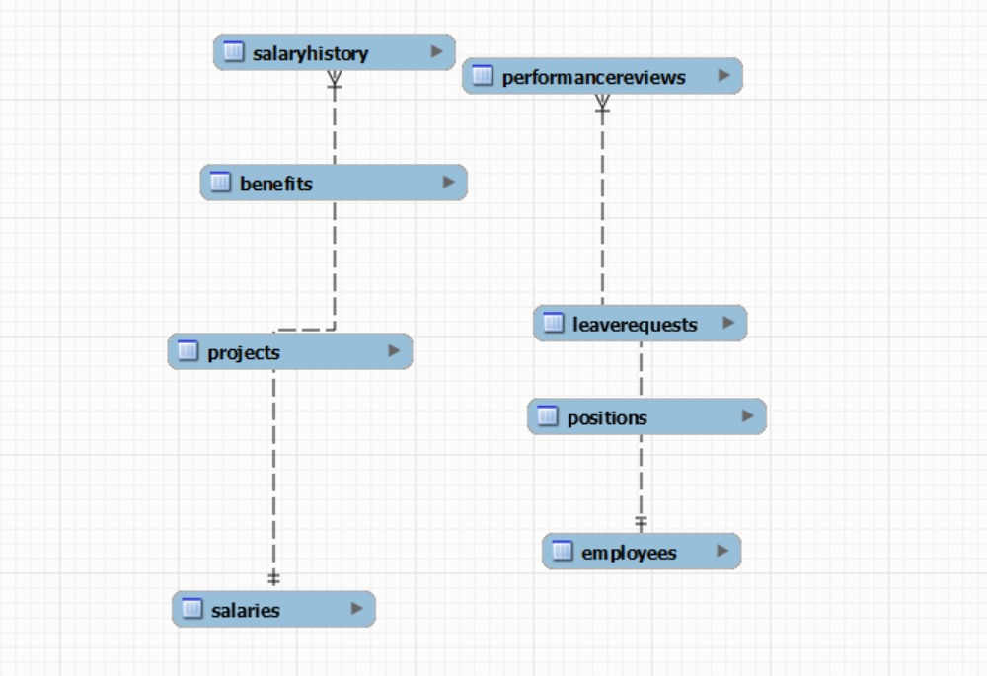
ER Diagram:

Slide 7

Concepts and techniques used:
Tables
constraints
Stored functions
Functions
Procedures
Triggers
Transactions

Slide 8
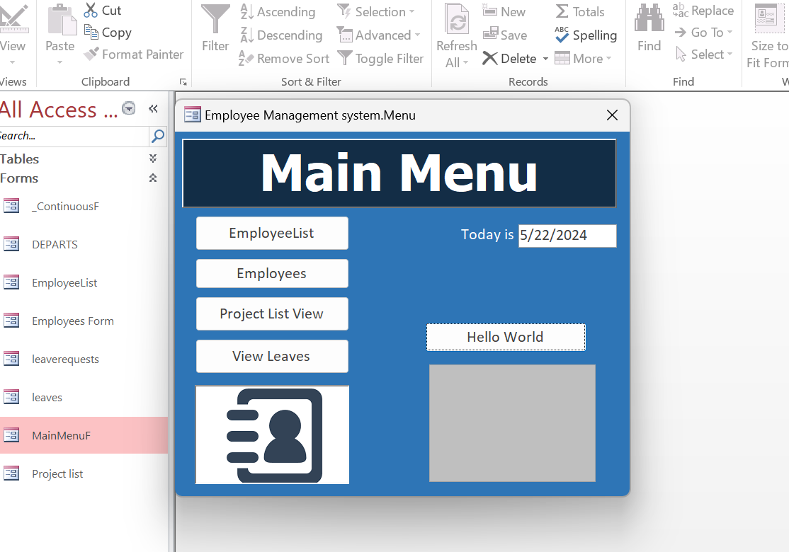
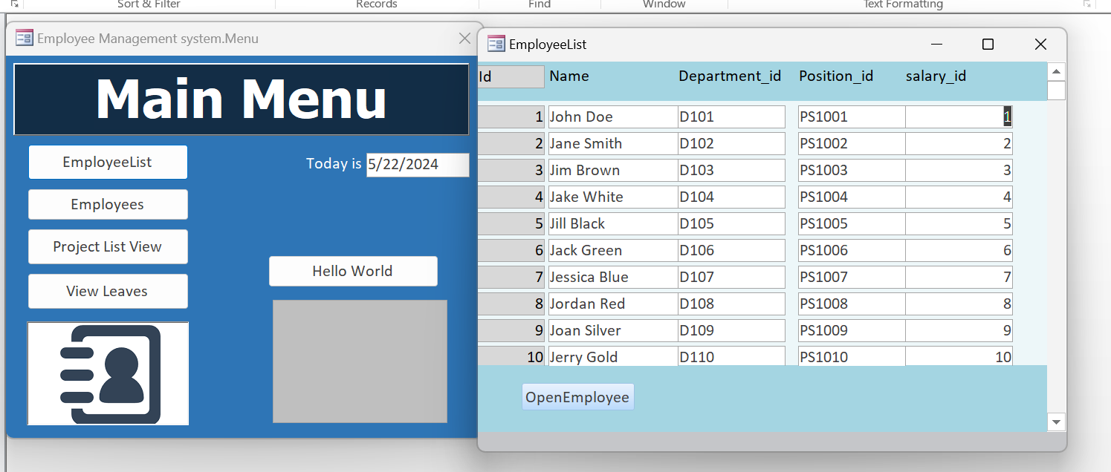
Interface:

Slide 9
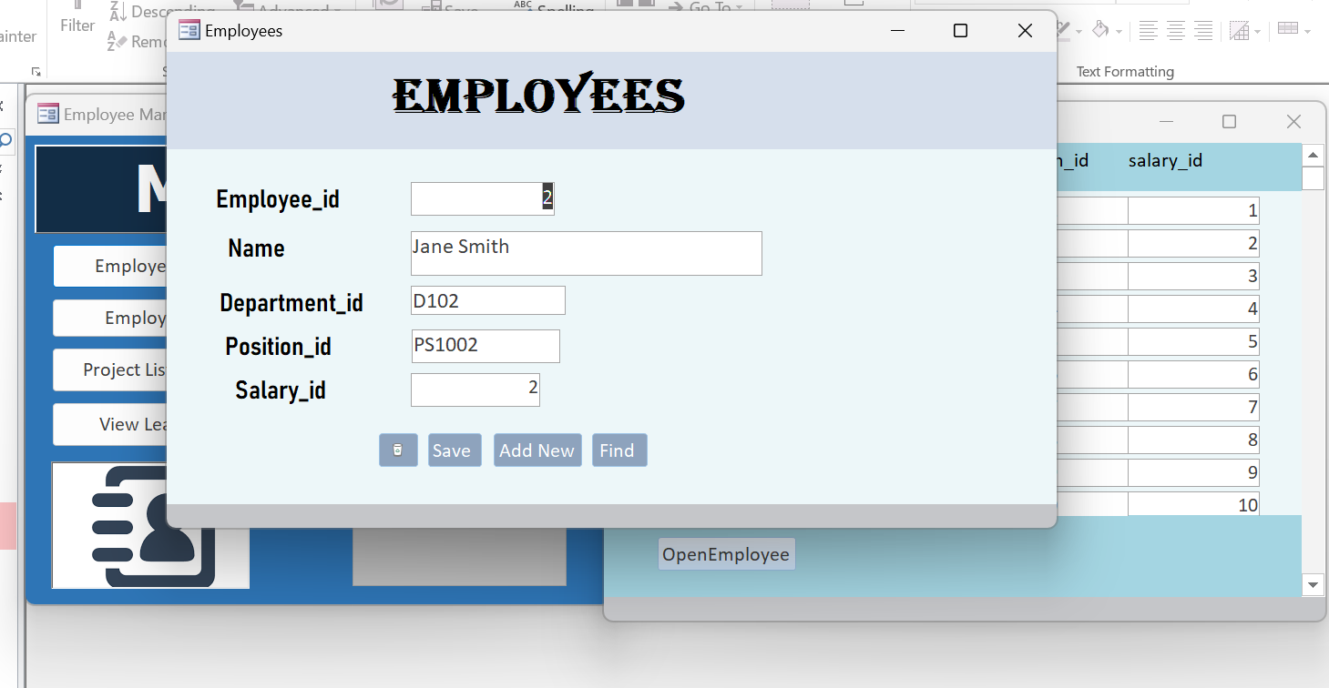
Interface:

Slide 10
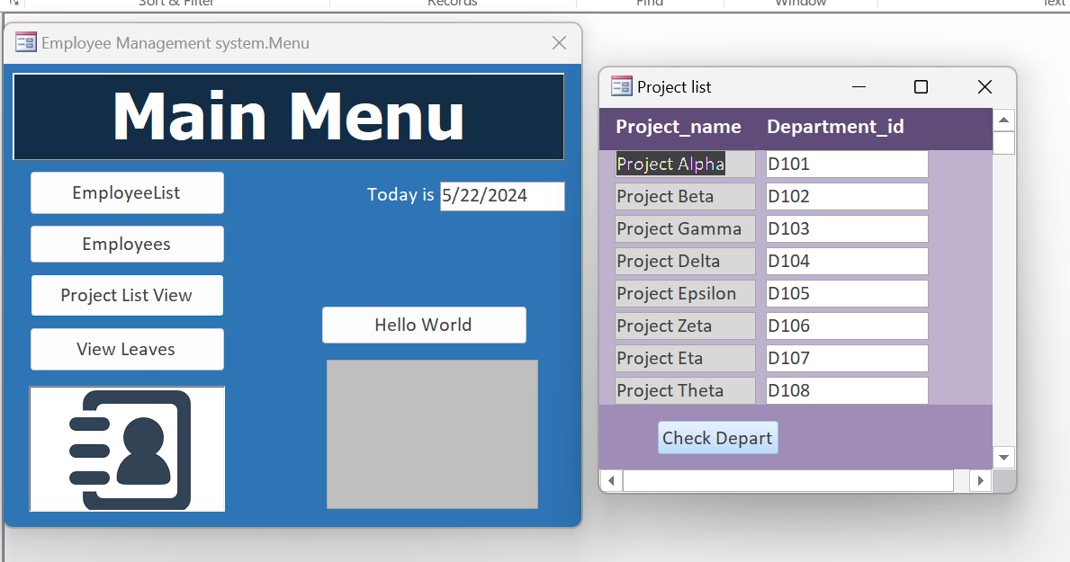
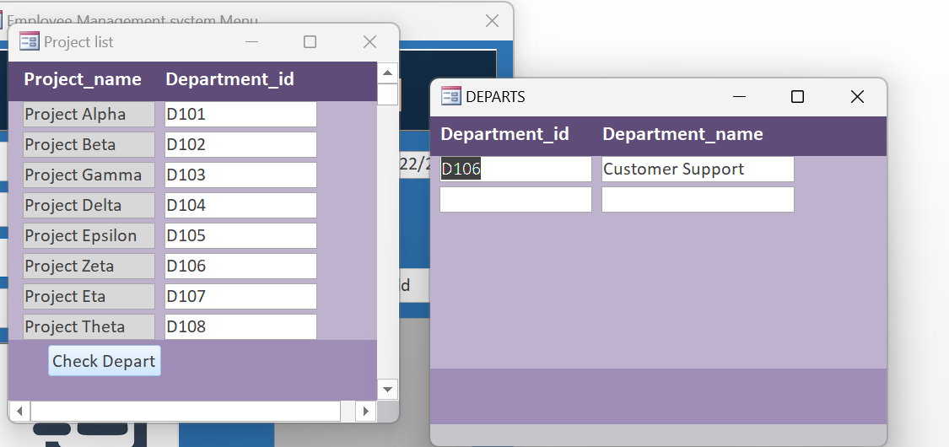
Interface:

Slide 11
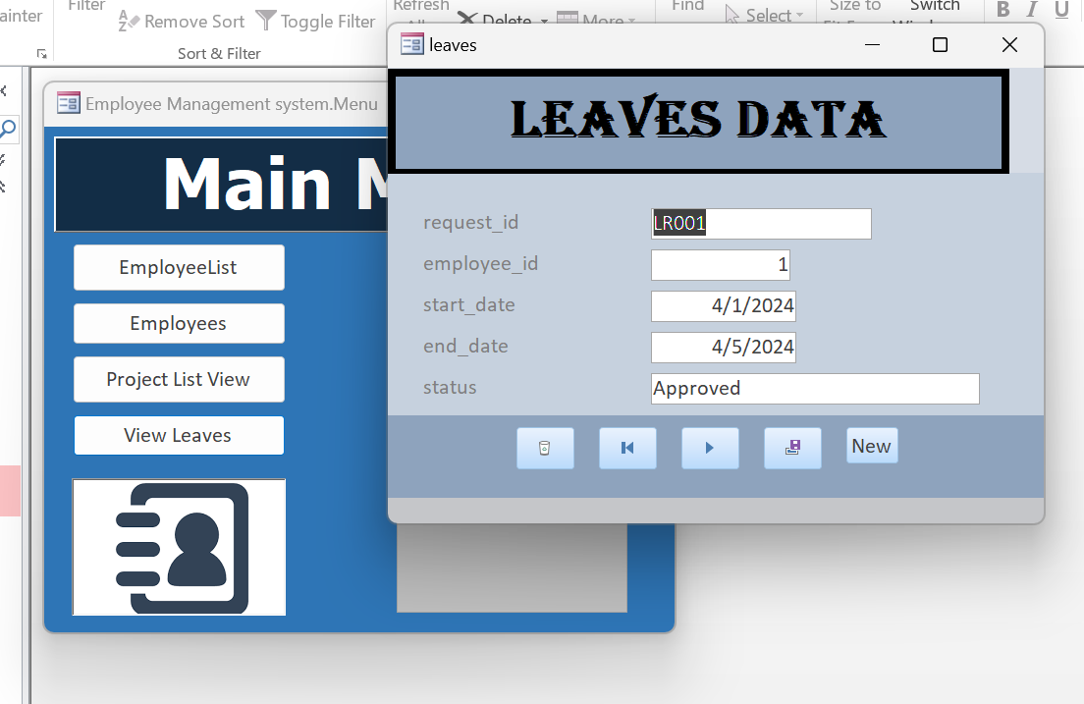
Interface:

Slide 12
Thank You!
Submitted by :
232487 – Jahanzaib Hassan.
232517 – Hussnain Dogar.

